Slide 1

OWASP Top-10 2013
Dave Wichers
OWASP Top 10 Project Lead
OWASP Board Member
COO/Cofounder, Aspect Security

Slide 2
About the OWASP Top 10
OWASP Top 10 is an Awareness Document
Not a standard…
First developed in 2003
Was probably 3rd or 4th OWASP project, after
Developers Guide
WebGoat
Maybe WebScarab ??
Released
2003, 2004, 2007, 2010, 2013

Slide 3
OWASP Top Ten (2013 Edition)
A1: Injection
A10: Unvalidated Redirects and Forwards
A5: Security Misconfiguration
A3: Cross-Site Scripting (XSS)
A2: Broken Authentication and Session Management
A4: Insecure Direct Object References
A7: Missing Function Level Access Control
A6: Sensitive Data Exposure
A8: Cross Site Request Forgery (CSRF)
A9: Using Known Vulnerable Components
Notes:
A9 is the only new item in the top 10 for 2013.

Slide 4
What Didn’t Change
It’s About Risks, Not Just Vulnerabilities
OWASP Top 10 Risk Rating Methodology
Title is: “The Top 10 Most Critical Web Application Security Risks”
Based on the OWASP Risk Rating Methodology, used to prioritize Top 10

Slide 5
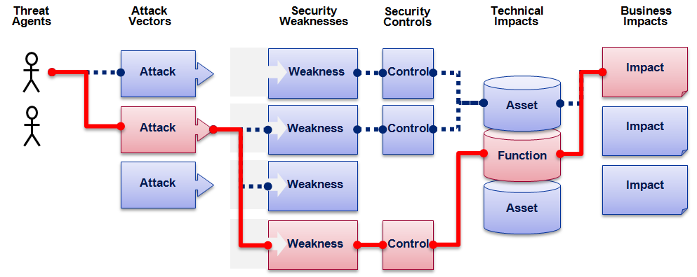

OWASP Top 10 Risk Rating Methodology
Threat Agent | Attack Vector | Weakness Prevalence | Weakness Detectability | Technical Impact | Business Impact
? | Easy | Widespread | Easy | Severe | ?
 | Average | Common | Average | Moderate
 | Difficult | Uncommon | Difficult | Minor
 | 1 | 2 | 2 | 1
 |  | 1.66 | * | 1
1
2
3
Injection Example
1.66 weighted risk rating

Slide 6
What’s Changed?
Risks Added, Risks Merged, Risks Reordered
Reordered: 7
Added: 1
Merged: 2 merged into 1
Broadened: 1
Development Methodology For 2013
Same as 2010, but
Used more sources of vulnerability data
All vulnerability data made public by each provider
Development Methodology for Next Version?
More transparency
Requested vulnerability data format
Earlier community involvement

Slide 7
Mapping from 2010 to 2013 Top 10
OWASP Top 10 – 2010 (old) | OWASP Top 10 – 2013 (New)
2010-A1 – Injection | 2013-A1 – Injection
2010-A2 – Cross Site Scripting (XSS) | 2013-A2 – Broken Authentication and Session Management
2010-A3 – Broken Authentication and Session Management | 2013-A3 – Cross Site Scripting (XSS)
2010-A4 – Insecure Direct Object References | 2013-A4 – Insecure Direct Object References
2010-A5 – Cross Site Request Forgery (CSRF) | 2013-A5 – Security Misconfiguration
2010-A6 – Security Misconfiguration | 2013-A6 – Sensitive Data Exposure
2010-A7 – Insecure Cryptographic Storage | 2013-A7 – Missing Function Level Access Control
2010-A8 – Failure to Restrict URL Access | 2013-A8 – Cross-Site Request Forgery (CSRF)
2010-A9 – Insufficient Transport Layer Protection | 2013-A9 – Using Known Vulnerable Components (NEW)
2010-A10 – Unvalidated Redirects and Forwards (NEW) | 2013-A10 – Unvalidated Redirects and Forwards
3 Primary Changes: | Merged: 2010-A7 and 2010-A9 -> 2013-A6
Added New 2013-A9: Using Known Vulnerable Components | 2010-A8 broadened to 2013-A7
Notes:
Broken Auth and Session Management moved up, we believe, because more consulting organizations were included in this data set, and they can find this better than automated tools can. We don’t believe the actual prevalence of this issue increased, just the measured prevalence.
CSRF dropped we believe because organizations are getting a handle on this new issue that was first added to the Top 10 in 2007. The awareness the Top 10 raised, has helped reduce the prevalence of this issue (we believe).

Slide 8
2013-A1 – Injection
Injection means…
Tricking an application into including unintended commands in the data sent to an interpreter
Interpreters…
Take strings and interpret them as commands
SQL, OS Shell, LDAP, XPath, Hibernate, etc…
SQL injection is still quite common
Many applications still susceptible (really don’t know why)
Even though it’s usually very simple to avoid
Typical Impact
Usually severe. Entire database can usually be read or modified
May also allow full database schema, or account access, or even OS level access

Slide 9
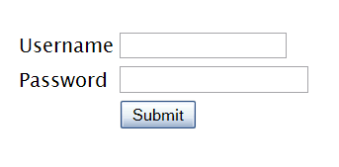
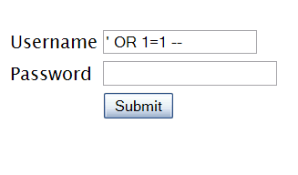

SQL Injection – Illustrated
"SELECT * FROM accounts WHERE acct=‘’ OR 1=1--’"
Account Summary
Acct:5424-6066-2134-4334
Acct:4128-7574-3921-0192
Acct:5424-9383-2039-4029
Acct:4128-0004-1234-0293
Account:
Account:
SKU:
DB Table 

SKU:
HTTP response 

HTTP request
Finance
SQL query
Transactions
Accounts
Administration
Communication
Knowledge Mgmt
E-Commerce
Bus. Functions
Databases
Legacy Systems
Web Services
Directories
Billing
Application Layer
Human Resrcs
APPLICATION ATTACK
Custom Code
1. Application presents a form to the attacker
2. Attacker sends an attack in the form data
App Server
3. Application forwards attack to the database in a SQL query
Web Server
Hardened OS
4. Database runs query containing attack and sends encrypted results back to application
Network Layer
Firewall
Firewall
5. Application decrypts data as normal and sends results to the user

Slide 10
A1 – Avoiding Injection Flaws
Recommendations
Avoid the interpreter entirely, or
Use an interface that supports bind variables (e.g., prepared statements, or stored procedures),
Bind variables allow the interpreter to distinguish between code and data
Encode all user input before passing it to the interpreter
Always perform ‘white list’ input validation on all user supplied input
Always minimize database privileges to reduce the impact of a flaw
References
For more details, read the https://www.owasp.org/index.php/SQL_Injection_Prevention_Cheat_Sheet

Slide 11
2013-A2 – Broken Authentication and Session Management
HTTP is a “stateless” protocol
Means credentials have to go with every request
Should use SSL for everything requiring authentication
Session management flaws
SESSION ID used to track state since HTTP doesn’t
and it is just as good as credentials to an attacker
SESSION ID is typically exposed on the network, in browser, in logs, …
Beware the side-doors
Change my password, remember my password, forgot my password, secret question, logout, email address, etc…
Typical Impact
User accounts compromised or user sessions hijacked

Slide 12
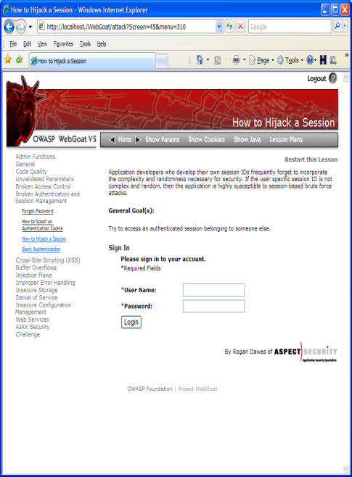

Broken Authentication Illustrated
1
User sends credentials
Finance
Transactions
Accounts
Administration
Communication
Knowledge Mgmt
E-Commerce
www.boi.com?JSESSIONID=9FA1DB9EA...
Bus. Functions
Site uses URL rewriting
(i.e., put session in URL)
2
Custom Code
3
User clicks on a link to http://www.hacker.com in a forum
Hacker checks referrer logs on www.hacker.com
and finds user’s JSESSIONID
4
5
Hacker uses JSESSIONID and takes over victim’s account

Slide 13
A2 – Avoiding Broken Authentication and Session Management
Verify your architecture
Authentication should be simple, centralized, and standardized
Use the standard session id provided by your container
Be sure SSL protects both credentials and session id at all times
Verify the implementation
Forget automated analysis approaches
Check your SSL certificate
Examine all the authentication-related functions
Verify that logoff actually destroys the session
Use OWASP’s WebScarab to test the implementation
Follow the guidance from
https://www.owasp.org/index.php/Authentication_Cheat_Sheet

Slide 14
2013-A3 – Cross-Site Scripting (XSS)
Occurs any time…
Raw data from attacker is sent to an innocent user’s browser
Raw data…
Stored in database
Reflected from web input (form field, hidden field, URL, etc…)
Sent directly into rich JavaScript client
Virtually every web application has this problem
Try this in your browser – javascript:alert(document.cookie)
Typical Impact
Steal user’s session, steal sensitive data, rewrite web page, redirect user to phishing or malware site
Most Severe: Install XSS proxy which allows attacker to observe and direct all user’s behavior on vulnerable site and force user to other sites

Slide 15
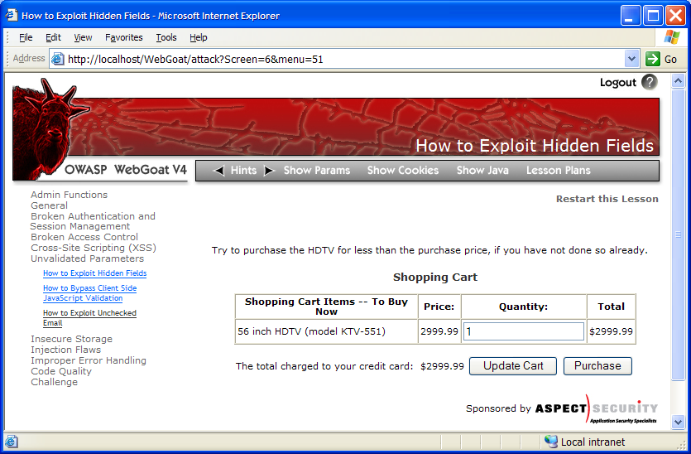
Cross-Site Scripting Illustrated
1
Attacker sets the trap – update my profile
Application with stored XSS vulnerability
Attacker enters a malicious script into a web page that stores the data on the server
2
Victim views page – sees attacker profile
Finance
Transactions
Accounts
Administration
Communication
Knowledge Mgmt
E-Commerce
Bus. Functions
Custom Code
Script runs inside victim’s browser with full access to the DOM and cookies
3
Script silently sends attacker Victim’s session cookie

Slide 16
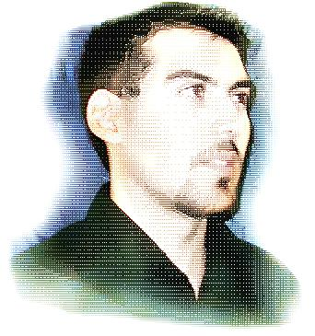
Avoiding XSS Flaws
Recommendations
Eliminate Flaw
Don’t include user supplied input in the output page
Defend Against the Flaw
Use Content Security Policy (CSP)
Primary Recommendation: Output encode all user supplied input (Use OWASP’s ESAPI or Java Encoders to output encode)
https://www.owasp.org/index.php/ESAPI
https://www.owasp.org/index.php/OWASP_Java_Encoder_Project
Perform ‘white list’ input validation on all user input to be included in page
For large chunks of user supplied HTML, use OWASP’s AntiSamy to sanitize this HTML to make it safe
See: https://www.owasp.org/index.php/AntiSamy
References
For how to output encode properly, read the https://www.owasp.org/index.php/XSS_(Cross Site Scripting) Prevention Cheat Sheet
(AntiSamy)

Slide 17
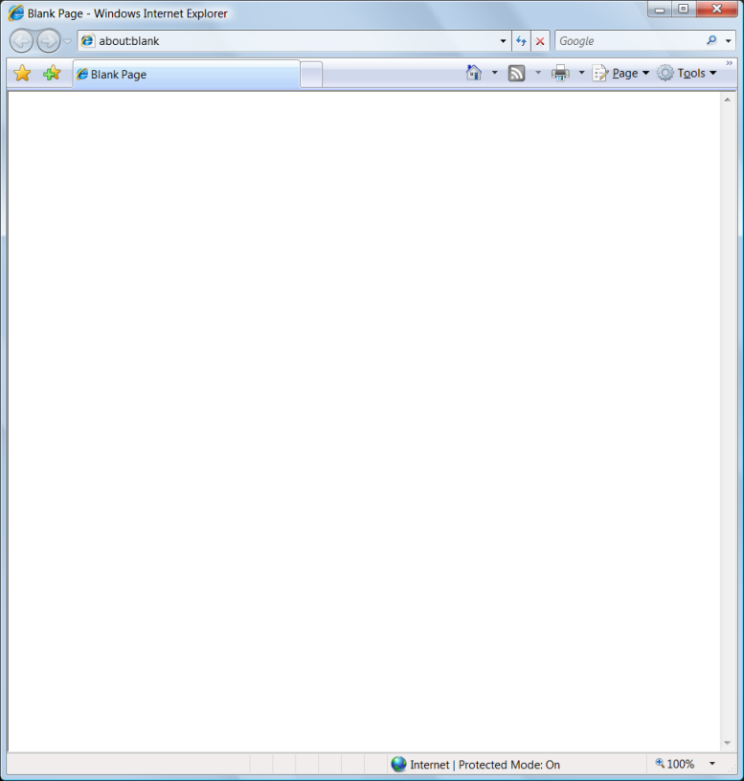
Safe Escaping Schemes in Various HTML Execution Contexts
#1: ( &, <, >, " ) → &entity; ( ', / ) → &#xHH;
ESAPI: encodeForHTML()
HTML Element Content
(e.g., <div> some text to display </div> )
#2: All non-alphanumeric < 256 → &#xHH;
ESAPI: encodeForHTMLAttribute()
HTML Attribute Values
(e.g., <input name='person' type='TEXT' value='defaultValue'> )
#3: All non-alphanumeric < 256 → \xHH
ESAPI: encodeForJavaScript()
JavaScript Data
(e.g., <script> someFunction(‘DATA’)</script> )
#4: All non-alphanumeric < 256 → \HH
ESAPI: encodeForCSS()
CSS Property Values
(e.g., .pdiv a:hover {color: red; text-decoration: underline} )
#5: All non-alphanumeric < 256 → %HH
ESAPI: encodeForURL()
URI Attribute Values
(e.g., <a href=" http://site.com?search=DATA" )
ALL other contexts CANNOT include Untrusted Data
Recommendation: Only allow #1 and #2 and disallow all others
See: www.owasp.org/index.php/XSS_(Cross_Site_Scripting)_Prevention_Cheat_Sheet

Slide 18
2013-A4 – Insecure Direct Object References
How do you protect access to your data?
This is part of enforcing proper “Authorization”, along with A7 – Failure to Restrict URL Access
A common mistake …
Only listing the ‘authorized’ objects for the current user, or
Hiding the object references in hidden fields
This is called presentation layer access control, and doesn’t work
Attacker simply tampers with parameter value
Typical Impact
Users are able to access unauthorized files or data
… and then not enforcing these restrictions on the server side

Slide 19
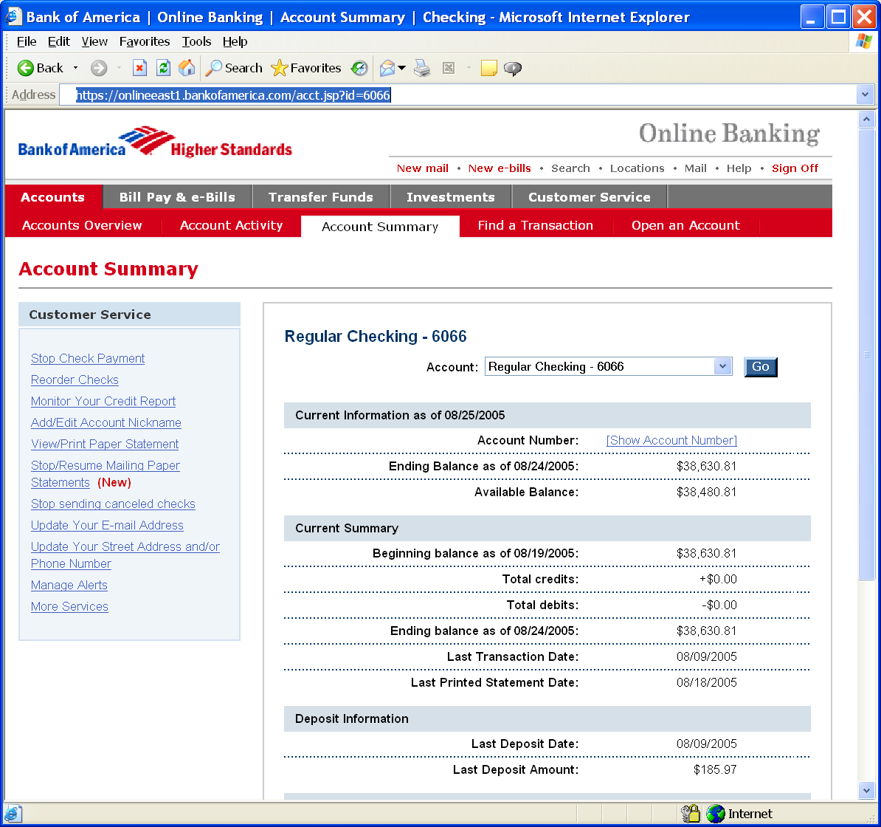
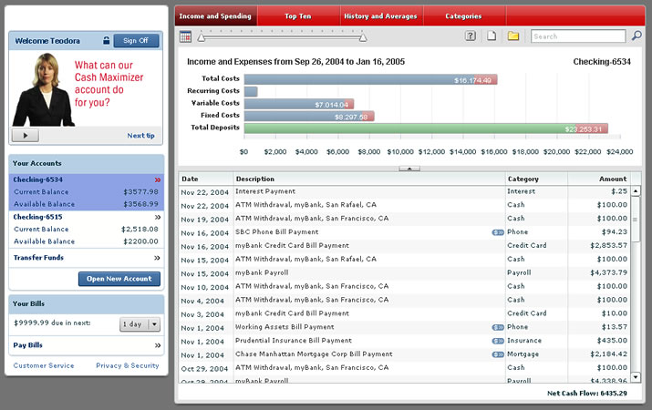
Insecure Direct Object References Illustrated
Attacker notices his acct parameter is 6065
?acct=6065
He modifies it to a nearby number
?acct=6066
Attacker views the victim’s account information
https://www.onlinebank.com/user?acct=6065

Slide 20
A4 – Avoiding Insecure Direct Object References
Eliminate the direct object reference
Replace them with a temporary mapping value (e.g. 1, 2, 3)
ESAPI provides support for numeric & random mappings
IntegerAccessReferenceMap & RandomAccessReferenceMap
Validate the direct object reference
Verify the parameter value is properly formatted
Verify the user is allowed to access the target object
Query constraints work great!
Verify the requested mode of access is allowed to the target object (e.g., read, write, delete)
http://app?file=Report123.xls
Access
Reference
Map
Report123.xls
http://app?file=1
http://app?id=9182374
Acct:9182374
http://app?id=7d3J93

Slide 21
2013-A5 – Security Misconfiguration
Web applications rely on a secure foundation
Everywhere from the OS up through the App Server
Is your source code a secret?
Think of all the places your source code goes
Security should not require secret source code
CM must extend to all parts of the application
All credentials should change in production
Typical Impact
Install backdoor through missing OS or server patch
Unauthorized access to default accounts, application functionality or data, or unused but accessible functionality due to poor server configuration

Slide 22
Security Misconfiguration Illustrated
Finance
Database
Transactions
Accounts
Administration
Communication
Knowledge Mgmt
E-Commerce
Bus. Functions
Custom Code
App Configuration
Framework
Development
App Server
Web Server
QA Servers
Insider
Hardened OS
Test Servers
Source Control

Slide 23
Avoiding Security Misconfiguration
Verify your system’s configuration management
Secure configuration “hardening” guideline
Automation is REALLY USEFUL here
Must cover entire platform and application
Analyze security effects of changes
Can you “dump” the application configuration
Build reporting into your process
If you can’t verify it, it isn’t secure
Verify the implementation
Scanning finds generic configuration and missing patch problems

Slide 24
2013-A6 – Sensitive Data Exposure
Storing and transmitting sensitive data insecurely
Failure to identify all sensitive data
Failure to identify all the places that this sensitive data gets stored
Databases, files, directories, log files, backups, etc.
Failure to properly protect this data in every location
Typical Impact
Attackers access or modify confidential or private information
Attackers extract secrets to use in additional attacks
Company embarrassment, customer dissatisfaction, and loss of trust
Expense of cleaning up the incident, such as forensics, sending apology letters, reissuing thousands of credit cards, providing identity theft insurance
Business gets sued and/or fined
e.g, credit cards, health care records, financial data (yours or your customers)
Failure to identify all the places that this sensitive data is sent
On the web, to backend databases, to business partners, internal communications
Notes:
(Insecure Cryptographic Storage & insecure channel protection)

Slide 25
Insecure Cryptographic Storage Illustrated
Victim enters credit card number in form
1
Finance
Transactions
Accounts
Administration
Communication
Knowledge Mgmt
E-Commerce
Bus. Functions
Custom Code
Log files
4
Malicious insider steals 4 million credit card numbers
Error handler logs CC details because merchant gateway is unavailable
2
Logs are accessible to all members of IT staff for debugging purposes
3

Slide 26
Avoiding Insecure Cryptographic Storage
Verify your architecture
Identify all sensitive data
Identify all the places that data is stored
Ensure threat model accounts for possible attacks
Use encryption to counter the threats, don’t just ‘encrypt’ the data
Protect with appropriate mechanisms
File encryption, database encryption, data element encryption
Use the mechanisms correctly
Use standard strong algorithms
Generate, distribute, and protect keys properly
Be prepared for key change
Verify the implementation
A standard strong algorithm is used, and it’s the proper algorithm for this situation
All keys, certificates, and passwords are properly stored and protected
Safe key distribution and an effective plan for key change are in place
Analyze encryption code for common flaws

Slide 27


Insufficient Transport Layer Protection Illustrated
Business Partners
External Victim
Custom Code
Backend Systems
Employees
1
2
External attacker steals credentials and data off network
Internal attacker steals credentials and data from internal network
External Attacker
Internal Attacker

Slide 28
Avoiding Insufficient Transport Layer Protection
Protect with appropriate mechanisms
Use TLS on all connections with sensitive data
Use HSTS (HTTP Strict Transport Security)
Use key pinning
Individually encrypt messages before transmission
E.g., XML-Encryption
Sign messages before transmission
E.g., XML-Signature
Use the mechanisms correctly
Use standard strong algorithms (disable old SSL algorithms)
Manage keys/certificates properly
Verify SSL certificates before using them
Use proven mechanisms when sufficient
E.g., SSL vs. XML-Encryption
See: http://www.owasp.org/index.php/Transport_Layer_Protection_Cheat_Sheet for more details

Slide 29
2013-A7 – Missing Function Level Access Control
How do you protect access to URLs (pages)?
Or functions referenced by a URL plus parameters ?
This is part of enforcing proper “authorization”, along with A4 – Insecure Direct Object References
A common mistake …
Displaying only authorized links and menu choices
This is called presentation layer access control, and doesn’t work
Attacker simply forges direct access to ‘unauthorized’ pages
Typical Impact
Attackers invoke functions and services they’re not authorized for
Access other user’s accounts and data
Perform privileged actions

Slide 30
Missing Function Level Access Control Illustrated
Attacker notices the URL indicates his role
/user/getAccounts
He modifies it to another directory (role)
/admin/getAccounts, or
/manager/getAccounts
Attacker views more accounts than just their own

Slide 31
Avoiding Missing Function Level Access Control
For function, a site needs to do 3 things
Restrict access to authenticated users (if not public)
Enforce any user or role based permissions (if private)
Completely disallow requests to unauthorized page types (e.g., config files, log files, source files, etc.)
Verify your architecture
Use a simple, positive model at every layer
Be sure you actually have a mechanism at every layer
Verify the implementation
Forget automated analysis approaches
Verify that each URL (plus any parameters) referencing a function is protected by
An external filter, like Java EE web.xml or a commercial product
Or internal checks in YOUR code – e.g., use ESAPI’s isAuthorizedForURL() method
Verify the server configuration disallows requests to unauthorized file types
Use OWASP’s ZAP or your browser to forge unauthorized requests

Slide 32
2013-A8 – Cross Site Request Forgery (CSRF)
Cross Site Request Forgery
An attack where the victim’s browser is tricked into issuing a command to a vulnerable web application
Vulnerability is caused by browsers automatically including user authentication data (session ID, IP address, Windows domain credentials, …) with each request
Imagine…
What if a hacker could steer your mouse and get you to click on links in your online banking application?
What could they make you do?
Typical Impact
Initiate transactions (transfer funds, logout user, close account)
Access sensitive data
Change account details

Slide 33

CSRF Vulnerability Pattern
The Problem
Web browsers automatically include most credentials with each request
Even for requests caused by a form, script, or image on another site
All sites relying solely on automatic credentials are vulnerable!
(almost all sites are this way)
Automatically Provided Credentials
Session cookie
Basic authentication header
IP address
Client side SSL certificates
Windows domain authentication

Slide 34
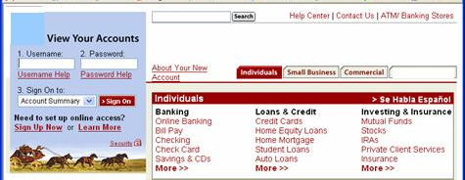
CSRF Illustrated
Attacker sets the trap on some website on the internet (or simply via an e-mail)
1
Application with CSRF vulnerability
Hidden <img> tag contains attack against vulnerable site
Finance
Transactions
Accounts
Administration
Communication
Knowledge Mgmt
E-Commerce
Bus. Functions
2
While logged into vulnerable site, victim views attacker site
Custom Code
3
Vulnerable site sees legitimate request from victim and performs the action requested
<img> tag loaded by browser – sends GET request (including credentials) to vulnerable site

Slide 35
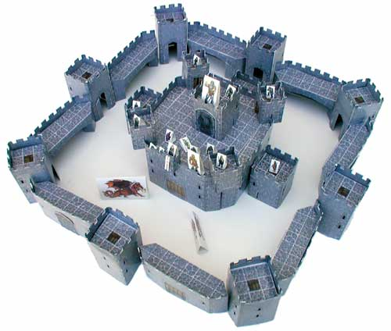
A8 – Avoiding CSRF Flaws
Add a secret, not automatically submitted, token to ALL sensitive requests
This makes it impossible for the attacker to spoof the request
(unless there’s an XSS hole in your application)
Tokens should be cryptographically strong or random
Options
Store a single token in the session and add it to all forms and links
Hidden Field: <input name="token" value="687965fdfaew87agrde" type="hidden"/>
Single use URL: /accounts/687965fdfaew87agrde
Form Token: /accounts?auth=687965fdfaew87agrde …
Beware exposing the token in a referer header
Hidden fields are recommended
Can have a unique token for each function
Use a hash of function name, session id, and a secret
Can require secondary authentication for sensitive functions (e.g., eTrade)
Don’t allow attackers to store attacks on your site
Properly encode all input on the way out
This renders all links/requests inert in most interpreters
See the: www.owasp.org/index.php/CSRF_Prevention_Cheat_Sheet
for more details

Slide 36
Everyone Uses Vulnerable Libraries
29 MILLION vulnerable downloads in 2011
Libraries | 31
Library Versions | 1,261
Organizations | 61,807
Downloads | 113,939,358
https://www.aspectsecurity.com/news/press/the-unfortunate-reality-of-insecure-libraries
Notes:
This is why A9 was added to the OWASP Top 10 in 2013. Everyone uses vulnerable libraries and we need to get processes and tools in place to significantly reduce their use!!

Slide 37
2013-A9 – Using Known Vulnerable Components
Vulnerable Components Are Common
Some vulnerable components (e.g., framework libraries) can be identified and exploited with automated tools
Widespread
Virtually every application has these issues because most development teams don’t focus on ensuring their components/libraries are up to date
Typical Impact
Full range of weaknesses is possible, including injection, broken access control, XSS ...
In many cases, the developers don’t even know all the components they are using, never mind their versions. Component dependencies make things even worse
This expands the threat agent pool beyond targeted attackers to include chaotic actors
The impact could range from minimal to complete host takeover and data compromise

Slide 38
What Can You Do to Avoid This?
Ideal
Automation checks periodically (e.g., nightly build) to see if your libraries are out of date
Even better, automation also tells you about known vulnerabilities
Minimum
By hand, periodically check to see if your libraries are out of date and upgrade those that are
If any are out of date, but you really don’t want to upgrade, check to see if there are any known security issues with these out of data libraries
If so, upgrade those
Could also
By hand, periodically check to see if any of your libraries have any known vulnerabilities at this time
Check CVE, other vuln repositories
If any do, update at least these

Slide 39
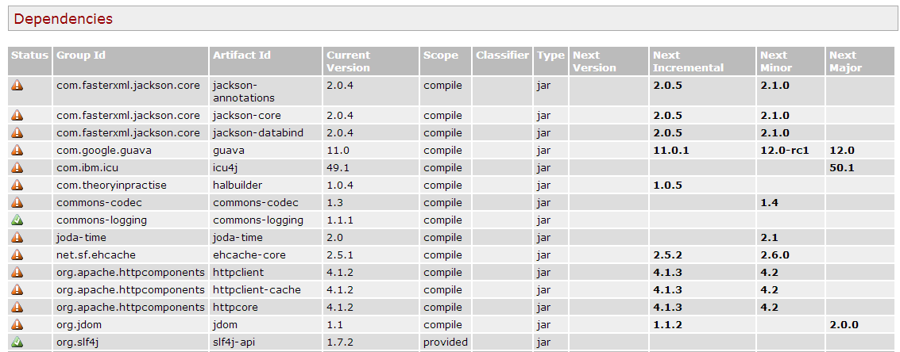
Automation Example for Java – Use Maven ‘Versions’ Plugin
Output from the Maven Versions Plugin – Automated Analysis of Libraries’ Status against Central repository
Most out of Date!
Details Developer Needs
This can automatically be run EVERY TIME software is built!!
Notes:
The Versions plugin is free. If you use Maven, you can have Versions run automatically on the libraries used by your project. Versions will tell you if that library is using the latest version available in Maven central, and if not, what new versions are available. It doesn’t provide any vulnerability information, but at least automatically can tell you if your libraries are out of date.

Slide 40
2013-A10 – Unvalidated Redirects and Forwards
Web application redirects are very common
And frequently include user supplied parameters in the destination URL
If they aren’t validated, attacker can send victim to a site of their choice
Forwards (aka Transfer in .NET) are common too
They internally send the request to a new page in the same application
Sometimes parameters define the target page
If not validated, attacker may be able to use unvalidated forward to bypass authentication or authorization checks
Typical Impact
Redirect victim to phishing or malware site
Attacker’s request is forwarded past security checks, allowing unauthorized function or data access

Slide 41

Unvalidated Redirect Illustrated
1
Attacker sends attack to victim via email or webpage
From: Internal Revenue Service Subject: Your Unclaimed Tax Refund Our records show you have an unclaimed federal tax refund. Please click here to initiate your claim.
3
Application redirects victim to attacker’s site
2
Victim clicks link containing unvalidated parameter
Finance
Transactions
Accounts
Administration
Communication
Knowledge Mgmt
E-Commerce
Bus. Functions
Custom Code
Request sent to vulnerable site, including attacker’s destination site as parameter. Redirect sends victim to attacker site
Evil Site
4
Evil site installs malware on victim, or phish’s for private information
http://www.irs.gov/taxrefund/claim.jsp?year=2006& … &dest=www.evilsite.com

Slide 42
Unvalidated Forward Illustrated
1
Attacker sends attack to vulnerable page they have access to
Request sent to vulnerable page which user does have access to. Redirect sends user directly to private page, bypassing access control.
public void sensitiveMethod( HttpServletRequest request, HttpServletResponse response) {
try {
// Do sensitive stuff here.
...
}
catch ( ...
2
Application authorizes request, which continues to vulnerable page
Filter
3
Forwarding page fails to validate parameter, sending attacker to unauthorized page, bypassing access control
public void doPost( HttpServletRequest request, HttpServletResponse response) {
try {
String target = request.getParameter( "dest" ) );
...
request.getRequestDispatcher( target ).forward(request, response);
}
catch ( ...

Slide 43
A10 – Avoiding Unvalidated Redirects and Forwards
There are a number of options
Avoid using redirects and forwards as much as you can
If used, don’t involve user parameters in defining the target URL
If you ‘must’ involve user parameters, then either
Validate each parameter to ensure its valid and authorized for the current user, or
(preferred) – Use server side mapping to translate choice provided to user with actual target page
Defense in depth: For redirects, validate the target URL after it is calculated to make sure it goes to an authorized external site
ESAPI can do this for you!!
See: SecurityWrapperResponse.sendRedirect( URL )
http://owasp-esapi-java.googlecode.com/svn/trunk_doc/org/owasp/esapi/filters/ SecurityWrapperResponse.html#sendRedirect(java.lang.String)
Some thoughts about protecting Forwards
Ideally, you’d call the access controller to make sure the user is authorized before you perform the forward (with ESAPI, this is easy)
With an external filter, like Siteminder, this is not very practical
Next best is to make sure that users who can access the original page are ALL authorized to access the target page.

Slide 44
Summary: How do you address these problems?
Develop Secure Code
Follow the best practices in OWASP’s Guide to Building Secure Web Applications
https://www.owasp.org/index.php/Guide
And the cheat sheets: https://www.owasp.org/index.php/Cheat_Sheets
Use OWASP’s Application Security Verification Standard as a guide to what an application needs to be secure
https://www.owasp.org/index.php/ASVS
Use standard security components that are a fit for your organization
Use OWASP’s ESAPI as a basis for your standard components
https://www.owasp.org/index.php/ESAPI
Review Your Applications
Have an expert team review your applications
Review your applications yourselves following OWASP Guidelines
OWASP Code Review Guide: https://www.owasp.org/index.php/Code_Review_Guide
OWASP Testing Guide: https://www.owasp.org/index.php/Testing_Guide

Slide 45
Thank you OWASP Top-10 2013

